Slide 1
Propositional logic
By Dr. Sambit

Slide 2
Last Class Discussion
Basic gate operations
Tautologies and contradictions

Slide 3
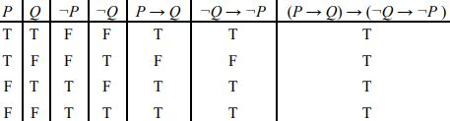
1. Tautologies
A Tautology is a formula which is always true for every value of its propositional variables.
Example: Prove that (P → Q) ⇒ (¬Q → ¬P ).
Check whether these two propositions are tautologies or not.
1. (p → q) ^ (r → q) , (p v r) → q
2. (p ↔ q), (p v q) ^ ¬(p ^ q)

Slide 4
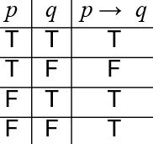
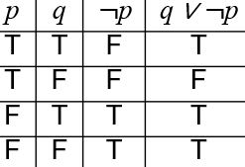
2. Logical equivalence
Definitions:
Two propositions p and q are logically equivalent if their truth tables are the same.
If p and q are logically equivalent, we write p ≡ q.
Example:
Look at the following two compound propositions: p → q and q ∨ ¬p.

Slide 5
2. Logical equivalence
Look at the following two compound propositions: p → q and q ∨ ¬p.
Show the following logical equivalences:
a. (p → q) ≡ (¬p v q)
b. (p → (q → r)) ≡ p → (¬q v r) ≡ (p ^ q) → r
c. P → (q → p) ≡ ¬p → (p → q)
d. P → (q v r) ≡ (p → q) v (p → r)
e. (p → q) ^ (r → q) ≡ (p v r) → q
f. (p ↔ q) ≡ (p v q) ^ ¬(p ^ q)

Slide 6
2. Logical equivalence
Show the following logical equivalences:
P → (q → p) ¬p → (p → q)
P | q | (q → p) | Final
T | T | T | T
T | F | T | T
F | T | F | T
F | F | T | T
P | q | ¬p | (p → q) | Final
T | T | F | T | T
T | F | F | F | T
F | T | T | T | T
F | F | T | T | T

Slide 7
3. CNF (Conjunctive normal form)
It is an approach to Boolean logic that expresses formulas as conjunctions of clauses with an AND or OR.
All series of “OR” is connected by AND operations
Examples
1. (A v B) ∧ (C v D)
2. (A v B) ∧ (¬C v B)
Questions:
(a) ¬(P →(Q ∧ R))

Slide 8
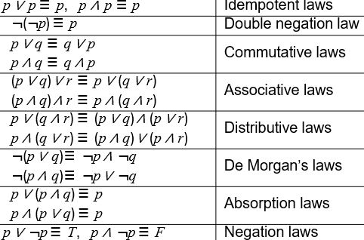
3. CNF
¬(P →(Q ∧ R))
¬P → ¬(Q ∧ R)
(¬P → ¬Q ) ∧ (¬P → ¬ R) (DISTRIBUTIVE)
(P v ¬Q) ∧ (P v ¬R)

Slide 9

3. CNF
(P →(Q ∧ R)) ∧ (¬P →(¬Q ∧ ¬R))
(b) (Q v (P ∧ R)) ∧ ¬((P v R) ∧ Q)
(c) ¬ ((P v ¬Q) ∧ ¬R)

Slide 10
3. CNF
(P →(Q ∧ R)) ∧ (¬P →(¬Q ∧ ¬R))
(P → Q ) ∧ (P → R) ∧ (¬P → ¬Q ) ∧ (¬P → ¬R)
(¬P v Q) ∧ (¬P v R) ∧ (P v ¬ Q) ∧ (P v ¬ R)

Slide 11
3. CNF
(b) (Q v (P ∧ R)) ∧ ¬((P v R) ∧ Q)
(Q v P) ∧ (Q v R) ∧ ¬(P v R) v ¬Q
(Q v P) ∧ (Q v R) ∧ (¬P ∧ ¬R) v ¬Q
(Q v P) ∧ (Q v R) ∧ (¬P v ¬Q) ∧ (¬ R v ¬Q )
Distributive law

Slide 12
3. CNF
¬ ((P v ¬Q) ∧ ¬R)
¬ (P v ¬Q) v R
(¬ P ∧ Q) v R
(¬ P v R) ∧ ( Q v R) (Distrubutive law)

Slide 13
4. DNF (Disjunctive normal form)
It is an approach to Boolean logic that expresses formulas as disjunctions of clauses with an AND or OR.
All series of “AND” is connected by OR operations
Examples
1. (A ∧ B) v (C ∧ D)
2. (A ∧ B) v (¬C ∧ B)
Questions:
(a) P ∧ (P →Q)
=>P ∧ (¬ P v Q)
=> (P ∧ ¬ P ) v (P ∧ Q )

Slide 14
5. Method to construct DNF
A disjunction of conjunctions where every variable or its negation is represented once in each conjunction (a minterm)
1. Construct a truth table for the proposition.
2. Check the T statement
If the variable is true, use the propositional variable in the minterm
If a variable is false, use the negation of the variable in the minterm
3. Connect the minterms with OR Logic (V).
p q p⊕q
T T F
T F T
F T T
F F F
(p∧¬q) ∨ (¬p∧q)

Slide 15
5. Method to construct DNF
How to find the DNF of (p ∨ q)→¬r

Slide 16
5. Method to construct DNF
How to find the DNF of (p ∨ q)→¬r
(p ∨ q)→¬r ⇔ (p∧q∧¬r) ∨ (p∧¬q∧¬r) ∨ (¬p∧q∧¬r) ∨ (¬p∧¬q∧r) ∨ (¬p∧¬q∧¬r)
p q r (p ∨ q) ¬r (p ∨ q)→¬r
T T T T F F
T T F T T T
T F T T F F
T F F T T T
F T T T F F
F T F T T T
F F T F F T
F F F F T T
There are five sets of input that make the statement true. Therefore there are five minterms.

Slide 17
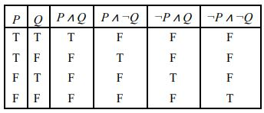
6. Principal Disjunctive Normal Form (PDNF)
Minterm: For a given number of variables, the minterm consists of conjunctions in which each statement variable or its negation, but not both, appears only once.
Let P and Q be the two statement variables.
Then there are 2^2 minterms given by P ∧ Q, P ∧ ¬Q, ¬P ∧ Q, and ¬P ∧ ¬Q

Slide 18
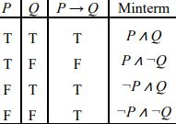
6. Principal Disjunctive Normal Form
(i). no two minterms are equivalent
(ii). Each minterm has the truth value T for exactly one combination of the truth values of the
variables P and Q
Obtain the PDNF of P → Q.
The PDNF of P → Q is (P ∧ Q) ∨ (¬P ∧ Q) ∨ (¬P ∧ ¬Q).

Slide 19
6. Principal Disjunctive Normal Form
(2) Obtain the PDNF for (P ∧ Q) ∨ (¬P ∧ R) ∨ (Q ∧ R).

Slide 20
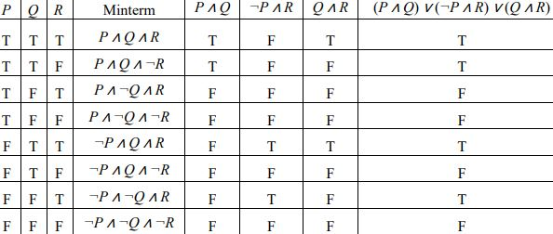
6. Principal Disjunctive Normal Form
(2) Obtain the PDNF for (P ∧ Q) ∨ (¬P ∧ R) ∨ (Q ∧ R).
The PDNF of (P ∧ Q) ∨ (¬P ∧ R) ∨ (Q ∧ R) is
(P ∧ Q ∧ R) ∨ (P ∧ Q ∧ ¬R) ∨ (¬P ∧ Q ∧ R) ∨ (¬P ∧ ¬Q ∧ R).

